Slide 1
A Brief Survey on Student Performance Prediction
ZHAO Yuqing
csyzhao1@comp.polyu.edu.hk

Slide 2
Outline
An Overview of Surveys Taxonomy
Input of Student Performance Prediction
Output of Student Performance Prediction
Provisional Taxonomy
Student Modeling
Appendix Charts

Slide 3
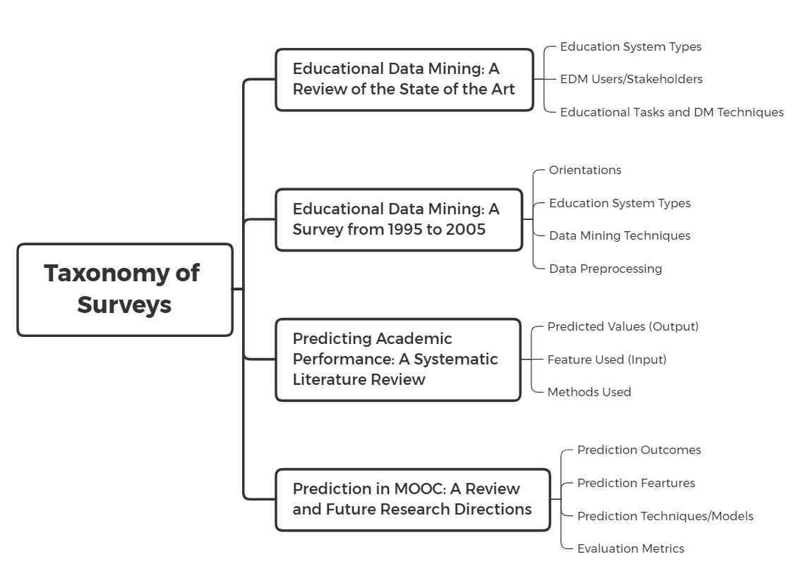
An Overview of Surveys Taxonomy
7 surveys about education data mining were found, 4 of which were relatively good
These four Surveys have different emphases
Two focuses on Prediction
Others are broader and consider users and orientations.
Taxonomy in common:
Input, method, output
Notes:
Application oriented. Focus on data mining field. 同样的作者，时间不同
Focus on prediction.
The others were duplicated, with low quality

Slide 4
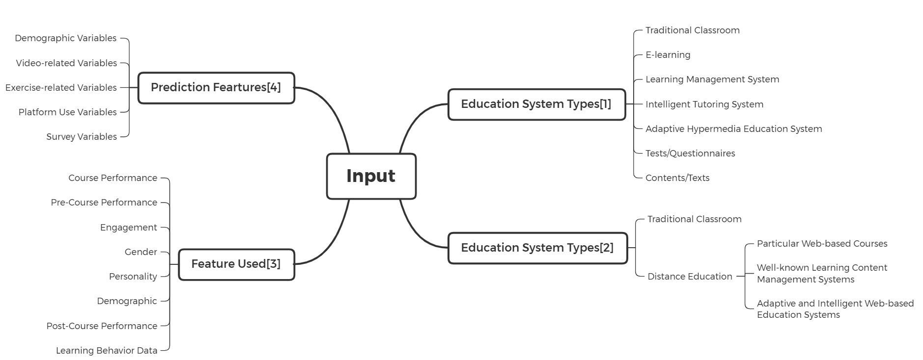
Input of Student Performance Prediction
According to domain knowledge
According to environment
[1]Romero, Cristóbal, and Sebastián Ventura. "Educational data mining: a review of the state of the art." IEEE Transactions on Systems, Man, and Cybernetics, Part C (Applications and Reviews) 40.6 (2010): 601-618.
[2]Romero, Cristobal, and Sebastian Ventura. "Educational data mining: A survey from 1995 to 2005." Expert systems with applications 33.1 (2007): 135-146.
[3]Hellas, Arto, et al. "Predicting academic performance: a systematic literature review." Proceedings Companion of the 23rd Annual ACM Conference on Innovation and Technology in Computer Science Education. 2018.
[4] Moreno-Marcos, Pedro Manuel, et al. "Prediction in MOOCs: A review and future research directions." IEEE Transactions on Learning Technologies 12.3 (2018): 384-401.
Notes:
对survey中input的一个总结对比
左边针对prediction的feature。[4]针对MOOC。这里的feature指的是不同语义的数据。
右边因为不只是针对prediction，所以按照教学环境划分数据。

Slide 5
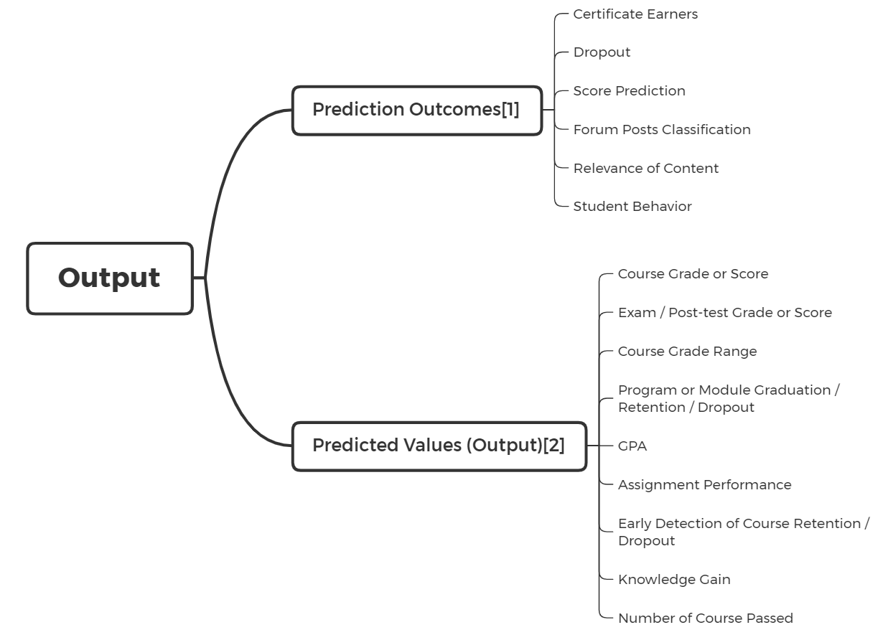
Output of Student Performance Prediction
[1] Moreno-Marcos, Pedro Manuel, et al. "Prediction in MOOCs: A review and future research directions." IEEE Transactions on Learning Technologies 12.3 (2018): 384-401.
[2]Hellas, Arto, et al. "Predicting academic performance: a systematic literature review." Proceedings Companion of the 23rd Annual ACM Conference on Innovation and Technology in Computer Science Education. 2018.
Notes:
prediction的两篇survey的output对比。
[1]是网络课程平台MOOC 做prediction的常用output，不只是针对student performance。
[2]是针对performance的常用output

Slide 6
Provisional Taxonomy
Student Modeling
(Feature Level)
Extract Student Modeling Feature
Graphical Feature
Sequential Feature
Static Feature
From System Environment Data
Traditional Education
Distant Learning
To Predict Outcome Value
GPA
CFA
Dropout
Graphical Feature
Sequential Feature
Static Feature
Distant Learning
Traditional Education
GPA
CFA
Dropout
System Environment
(Data Level)
Predicted Value
(Outcome)
Notes:
这里对student performance进行了一个分类。有两个角度参考了现有的survey。
Data level的可以改成data modality或者 data used。
Student modeling的分类是通过对比一些比较新的文章，为了突出multistage的contribution，但是分类还有命名可能不是特别准确。

Slide 7
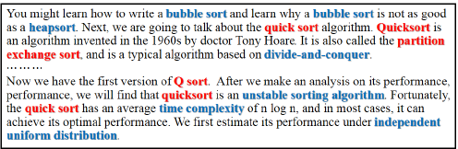
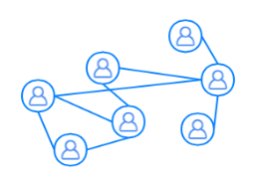

Student Modeling
Graphical Feature
Probabilistic Graphical Models: Bayesian Network[1-2], Course Concept Graph[3], Social Network[2][4-6]
Brings additional information of relationships between nodes into the model
Fig1. Example of course concepts
SLN Topology
Fig2. Social Learning Network: network between learners, teachers, and subjects
Fig3. Belief Network Modeling using Bayesian Network
[1]Bekele, Rahel, and Wolfgang Menzel. "A bayesian approach to predict performance of a student (bapps): A case with ethiopian students." algorithms 22.23 (2005): 24.
[2] Yang, Tsung-Yen, Christopher G. Brinton, and Carlee Joe-Wong. "Predicting learner interactions in social learning networks." IEEE INFOCOM 2018-IEEE Conference on Computer Communications. IEEE, 2018.
[3] Pan, Liangming, et al. "Course concept extraction in moocs via embedding-based graph propagation." Proceedings of the Eighth International Joint Conference on Natural Language Processing (Volume 1: Long Papers). 2017.
[4] Brinton, Christopher G., and Mung Chiang. "MOOC performance prediction via clickstream data and social learning networks." 2015 IEEE conference on computer communications (INFOCOM). IEEE, 2015.
[5] Yang, Tsung-Yen, et al. "Behavior-based grade prediction for MOOCs via time series neural networks." IEEE Journal of Selected Topics in Signal Processing 11.5 (2017): 716-728.
[6] Brinton, Christopher G., et al. "Social learning networks: Efficiency optimization for MOOC forums." IEEE INFOCOM 2016-The 35th Annual IEEE International Conference on Computer Communications. IEEE, 2016.
Notes:
这里对student modeling的分类做一个解释。Student modeling就是通过数据的一些时态顺序或者结构关系特征得到额外的信息，辅助预测。这一点在现有的survey中都没有明确提到。

Slide 8
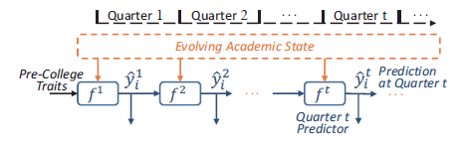
Student Modeling
Sequential Feature
Hidden Markov Model[1], Three-mode Tensor Factorization (on student/problem/time)[2][3], Quarter-wise Based Model[4], and others (using prior performance)[5-8]
Applying causality of temporal or sequential conditions to increase the accuracy of prediction
Fig1. Architecture of Quarter-wise Based Model. Prediction results of the previous quarter can be utilized in the prediction of the current quarter.
[1] Pardos, Zachary A., and Neil T. Heffernan. "Using HMMs and bagged decision trees to leverage rich features of user and skill from an intelligent tutoring system dataset." Journal of Machine Learning Research W & CP 40 (2010).
[2] Thai-Nghe, Nguyen, Tomáš Horváth, and Lars Schmidt-Thieme. "Factorization models for forecasting student performance." Educational Data Mining 2011. 2010.
[3] Meier, Yannick, et al. "Predicting grades." IEEE Transactions on Signal Processing 64.4 (2015): 959-972.
[4] Xu, Jie, et al. "Progressive prediction of student performance in college programs." Proceedings of the Thirty-First AAAI Conference on Artificial Intelligence. 2017.
[5] Piech, Chris, et al. "Deep knowledge tracing." Advances in neural information processing systems 28 (2015): 505-513.
[6] Bergner, Yoav, et al. "Model-Based Collaborative Filtering Analysis of Student Response Data: Machine-Learning Item Response Theory." International Educational Data Mining Society (2012).
[7] Romero, Cristóbal, et al. "Predicting students' final performance from participation in on-line discussion forums." Computers & Education 68 (2013): 458-472.
[8] Meier, Yannick, et al. "Predicting grades." IEEE Transactions on Signal Processing 64.4 (2015): 959-972.
Notes:
[1]学生答题时的one response from a student on a problem step，划分成不同的stage
matrix factorization.
Given a three-mode tensor Z of size U I T, where the first mode describes U students, the second
mode describes I tasks (problems), and the third mode describes the time.

Slide 9
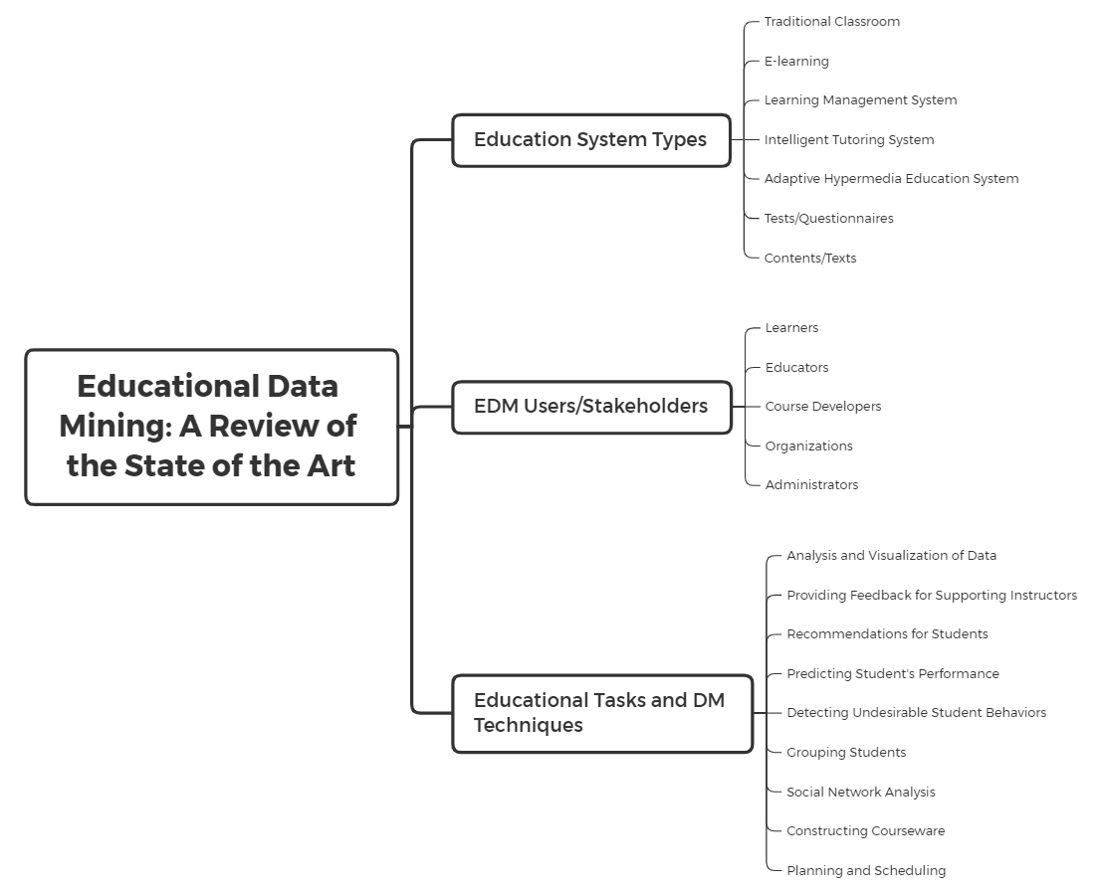

Slide 10
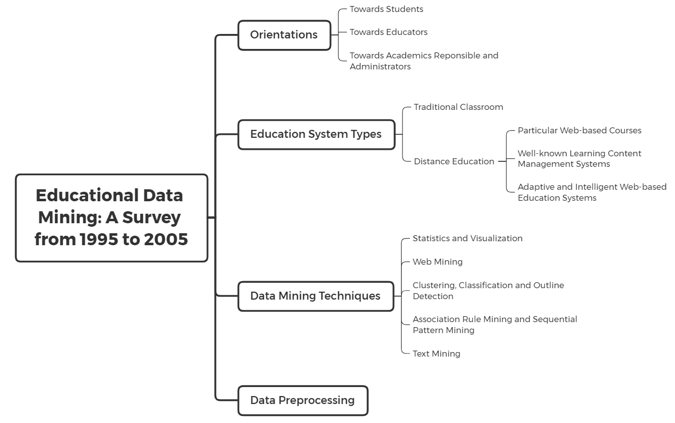

Slide 11
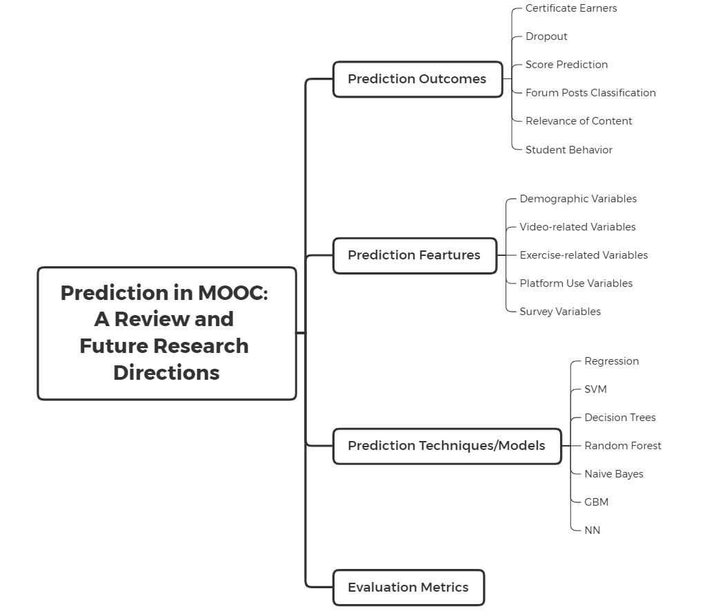

Slide 12
